Slide 1

Digital Real Estate Index
Will Fried, Shucheng Yan, Jessica Wijaya, Yixuan Di
Advisor: Zona Kostic

Slide 2
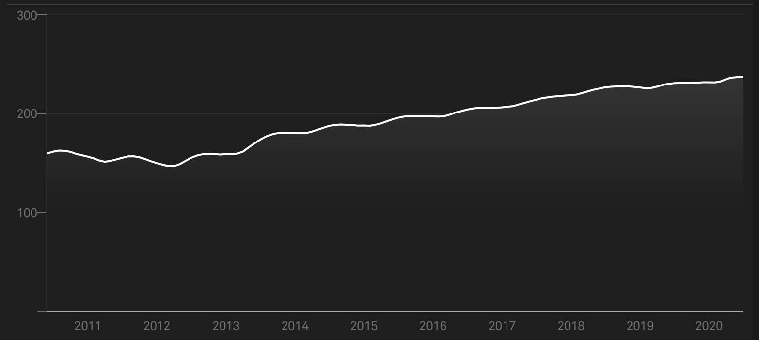
Real Estate Index (REI)
Measures overall health of real estate market
Indicators include:
Average selling price
Median days on market
Fraction of sales from first-time homebuyers
Indices include
National Association of Realtors Confidence Index
Case-Shiller Home Price Index
Home price index

Slide 3


Target audience of REIs
Homeowners
Real estate investors
Real estate developers
Real estate brokerage firms

Slide 4
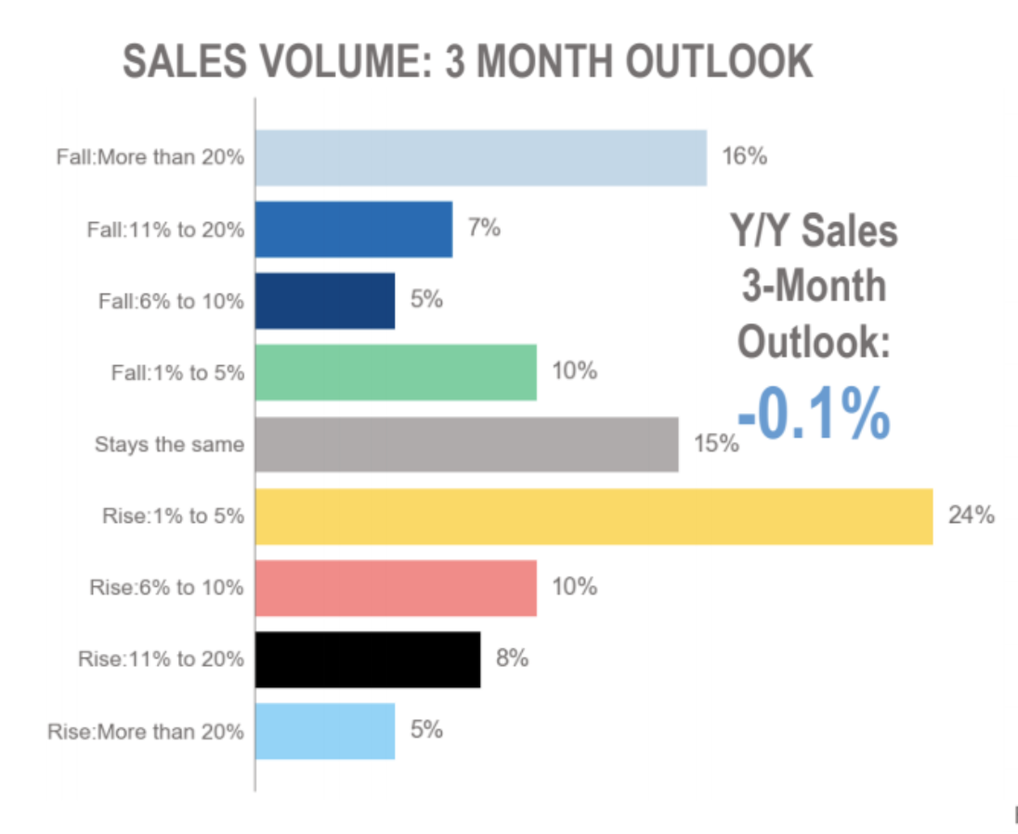
Shortcomings of existing REIs
Only uses traditional data
Difficult to make accurate and localized predictions
Notes:
Based on data that reflects current market conditions, not data that is predictive of what will happen in future

Slide 5

Project goals
Explore digital data that may be predictive of future market conditions
Notes:
Info about visitors to websites like Zillow and Redfin
Advertisers that won bids on a given website
Bidding price by region

Slide 6
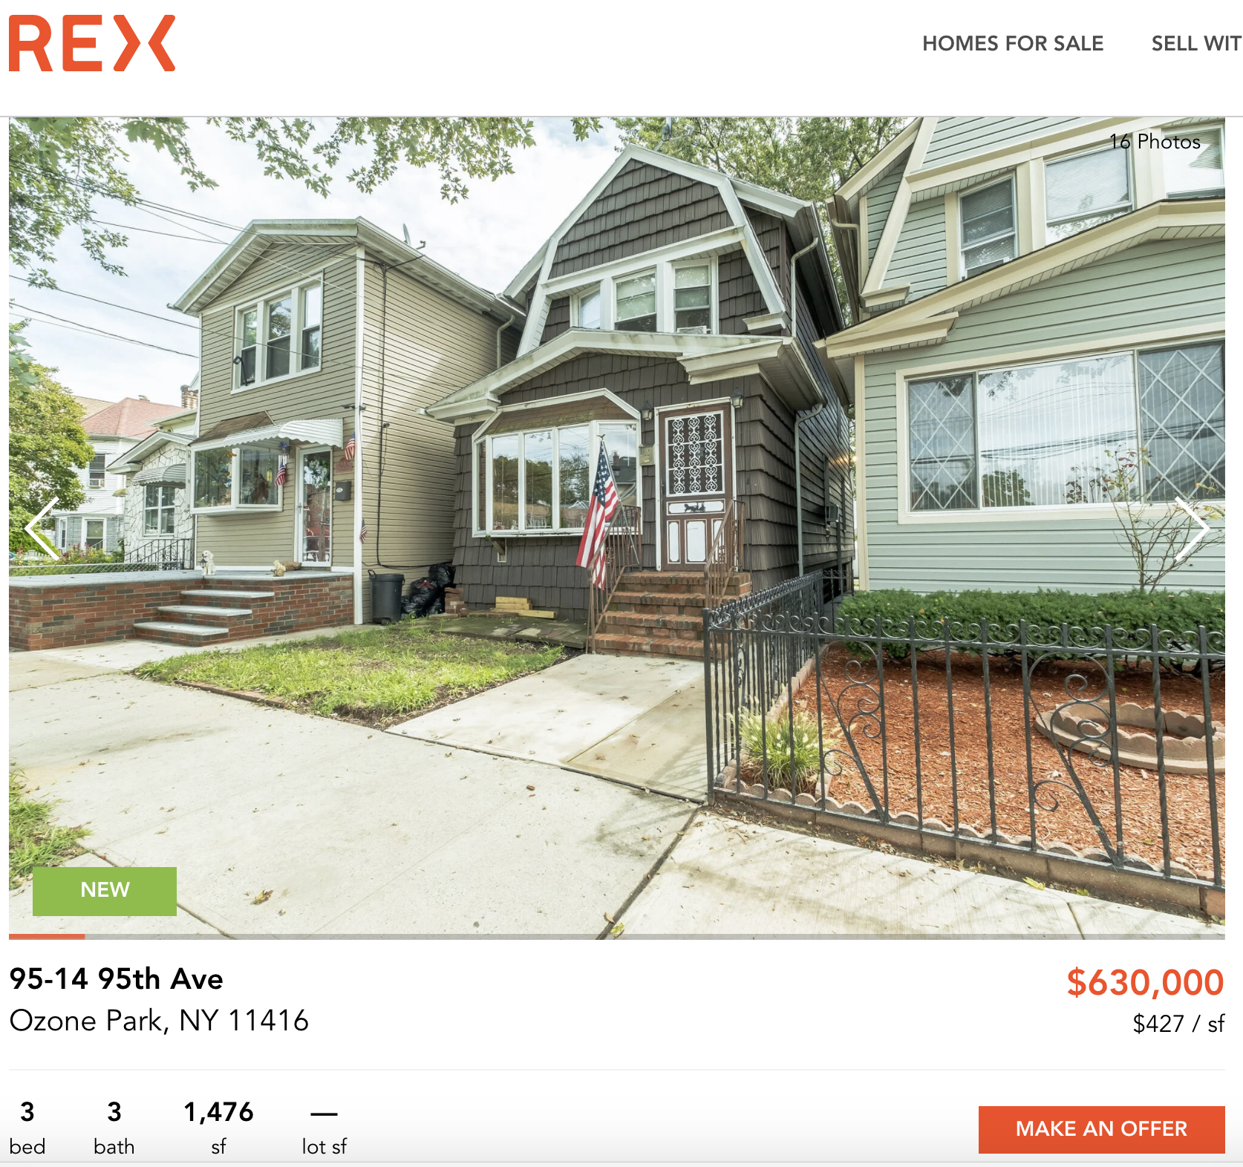
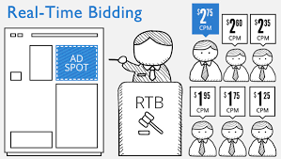
Project goals
Explore digital data that may be predictive of future market conditions
Online listings
Real time bidding info
Notes:
Info about visitors to websites like Zillow and Redfin
Advertisers that won bids on a given website
Bidding price by region

Slide 7
Project goals
Explore digital data that may be predictive of future market conditions:
Online listings
Real time bidding info
Link to traditional data sources
Census data
Deed and mortgage records
Notes:
Census data on household income, workplace migration, etc
Deed and mortgage records

Slide 8
Project goals
Explore digital data that may be predictive of future market conditions:
Online listings
Real time bidding info
Link to traditional data sources
Census data
Deed and mortgage records
Build predictive model

Slide 9

Rex Real Estate

